Slide 1
Hacking PHP for Fun and Profit
Why write in PHP when you can write PHP?
By Justin Dearing
President Long Island PHP User Group
<zippy1981@gmail.com>

Slide 2
Hacking PHP for Fun
If your at a PHP usergroup, you probably consider programming fun.
Fixing the interpreter/compiler for your language gives you bragging rights

Slide 3
Hacking PHP for Profit
Hack PHP
???????
PROFIT!!!!

Slide 4
Hacking PHP for indirect profit
You probably discovered this bug in PHP at your day job
Bragging rights on your resume
Increased positive internet visibility
Networking through speaking engagements

Slide 5
Goals
Discuss how to file a good bug report or enhancement request
Demonstrate how to build PHP on both Unix and Windows
Demonstrate how to write and run a PHP test (in PHP).
Demonstrate how to submit your test as a patch.
Case Study of two patches I wrote.

Slide 6
Back story for this talk
Once upon a time I had trouble consuming a .NET WCF Web Service with PHP.
I filed Bug #50698 and made a failed attempt to fix it. I then worked around the problem.
A few months later I was laid off. :(
I fixed the bug in my copious free time.
In my still copious free time I asked the PHP devs what grunt work needed to be done.
I worked on Bug #47435

Slide 7

For the non-C programmers
I can't make you a C programmer in one night.
Just being able to write a test, and follow the procedures for bug filing expedites the jobs of those that will fix the bug
If you want to learn C use the K&R book.

Slide 8
For the novice PHP programmer
If you want to report a bug you probably already have code that reproduces the error.
If you cannot produce test code for a feature request, you probably need to articulate your request to yourself better.
Learning to write a good bug report is helpful to the process.

Slide 9
SPOILER ALERT!!!
Index: php_sdl.c
===================================================================
--- php_sdl.c (revision 297347)
+++ php_sdl.c (working copy)
@@ -832,7 +832,12 @@
if (strncmp((char*)tmp->children->content, WSDL_HTTP_TRANSPORT, sizeof(WSDL_HTTP_TRANSPORT)) == 0) {
soapBinding->transport = SOAP_TRANSPORT_HTTP;
} else {
- soap_error1(E_ERROR, "Parsing WSDL: PHP-SOAP doesn't support transport '%s'", tmp->children->content);
+ // Since this is an E_NOTICE severity message, it will disappear into the ether.
+ soap_error1(E_NOTICE, "Parsing WSDL: PHP-SOAP doesn't support transport '%s'", tmp->children->content);
+ efree(soapBinding);
+ efree(tmpbinding);
+ trav = trav->next;
+ continue;
}
}
}
@@ -1128,6 +1133,10 @@
soap_error0(E_ERROR, "Parsing WSDL: Couldn't bind to service");
}
+ if (ctx.sdl->bindings == NULL || ctx.sdl->bindings->nNumOfElements == 0) {
+ soap_error0(E_ERROR, "Parsing WSDL: Could not find any usable binding services in WSDL.");
+ }
+
zend_hash_destroy(&ctx.messages);
zend_hash_destroy(&ctx.bindings);
zend_hash_destroy(&ctx.portTypes);
Notes:
Here I purposefully “ruin the ending,” of my own talk, by revealing the patch I wrote. I did this because its a long journey (read: lots of slides) to get to this point. Getting this patch submitted was a journey about as Epic as Frodo's journey from Bilbo's birthday party to destroying the ring and returning to the Shire. This is the point of Golem falling into the fires of Mordor with the ring.
Hopefully, the analogy above will point out that yes it was a long journey, but most of the sidetracks were neccessary.

Slide 10
Filing a good bug report
First read ESR's How To Ask Questions The Smart Way
I recommend using stackoverflow.com to verify your problem is a bug.
Make it as easy as possible to reproduce the bug.
Use github to store larger example cases.

Slide 11
Submitting the bug
Go to http://bugs.php.net/report.php
Fill out the form completely
Test case here should not be a formal unit test, you need to “sell” the bug here.

Slide 12
Building PHP
This takes a while, especially on windows. Make sure your bug is submitted before you start this.

Slide 13
Building PHP on Windows
Complete directions at
http://wiki.php.net/internals/windows/stepbystepbuild

Slide 14
Note
Don't expect help on the mailing list if you deviate from the official build directions too much

Slide 15
Prerequesites
Windows SDK 6.1 (earlier or later might not work)
Visual C++ 2008 Express Edition
binary-tools.zip
Some compiled binary libraries from this url
SVN
  Its good to have both the command line version and TortoiseSVN

Slide 16
Build Prep
Unzip the binary tools to c:\src\php-sdk
Start the sdk command prompt
  setenv /x86 /xp /release
  cd \src\php-sdk
  bin\phpsdk_setvars.bat
  bin\phpsdk_buildtree.bat php53dev
  cd \php53dev\vc9\x86
  start deps

Slide 17
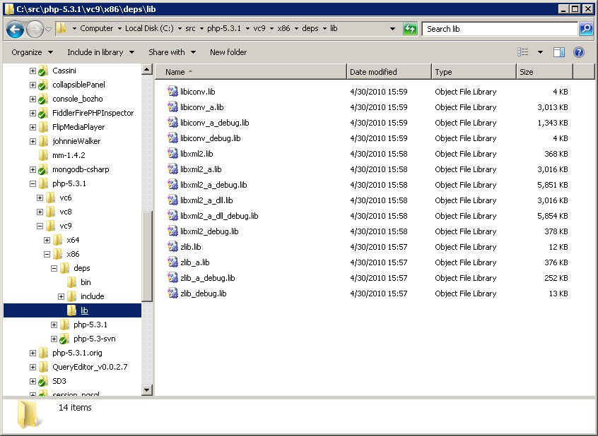
Build Prep (cont)
In the explorer window you just opened copy all the dependent DLLs.

Slide 18
Build Prep (cont)
From the same command prompt
  svn co http://svn.php.net/repository/php/php-src/branches/PHP_5_3 php-5.3-svn
  cd php-5.3-svn
  buildconf
  configure --disable-all --enable-cli --enable-cgi --enable-filter=shared --enable-libxml=shared --enable-soap=shared

Slide 19
Compiling
From the same command prompt
  nmake
  nmake test

Slide 20
Building PHP on Unix
Notes:
I don't go into many details here because unix folks tend to know how to compile their own software. Its a sad fact that many bright talented windows programmers and sysadmins just don't take the time to learn how to navigate a windows command prompt. I think this is changing for many reasons.
A second reason I don't go into many details is because other than the “buildconf” script, its just a matter of “./configure {litany of arguments} && make && make install”

Slide 21
Build Prep
Make sure you have gcc and friends installed
You need autoconf 2.13!!
Notes:
From what I gather from my occasional need to run autoconf, autoconf 2.65 is buggy
On another note, I am by no means an autoconf expert. I made one failed attempt to modify an autoconf script, back when I was young, stupid, and had too much time on my hands. However I am of the ignorant opinion that ERS is absolutely right when he says autoconf is hopelessly broken.

Slide 22
Configuring and building
Go to the shell
  PHP_AUTOCONF=autoconf213 ./buildconf
  ./configure --disable-all --enable-cli --enable-cgi --enable-filter=shared --enable-libxml=shared –enable-soap=shared
  make
  make test

Slide 23
Testing
Now that we got all that out of the way.

Slide 24
Writing a good test
Tests live in tests/ and ext/[module_name]/tests/
There is a module for everything, even var_filter()
Tests are written in php and have the extension .phpt
A test for a bug is named bug[number].phpt or bug[number]_X.phpt

Slide 25
My Tests
Adventures in Soap Mocking.
Notes:
I'm going to break from my tradition of entirely self contained slide decks, and not include my tests here. The tests will be included in a separate file.

Slide 26
Running your test with run-tests.php
Go back to your command prompt or shell
  UNIX: sapi/cli/php run-tests.php -p sapi/cli/php ext/[module]/bug[number]
  WINDOWS: Release_TS\php run-tests.php -p Release-TS\php.exe ext\[module]\bug[number].phpt

Slide 27
Submitting your test as a patch
From your command prompt (adjust slashes for OS):
  svn add ext/[name]/tests/bug[number].phpt
  svn diff ext/[name]/tests > bug[number]-tests.patch
Add patch to ticket
Add comment on ticket with any notes

Slide 28
Fixing the Bug
This is where we write in C
Note: Please try this at home!!!

Slide 29
Case Study: Modifying SoapClient
Join my on the journey that I called bug 50698

Slide 30
Notes about Soap
ext/soap contains SoapClient and SoapServer
Soap depends on xml, libxml and iconv

Slide 31
Editing Soap Module in VS
The Soap module has a Visual Studio 6.0 project that can be imported by Visual Studio 2008
If you configure the debugger to start php.exe, you can step through the soap code

Slide 32
Editing Soap Module in UNIX
On UNIX I use GVIM to write C.
Some files have vim annotations in them
I don't know how to use gdb, or any unix debugger.

Slide 33
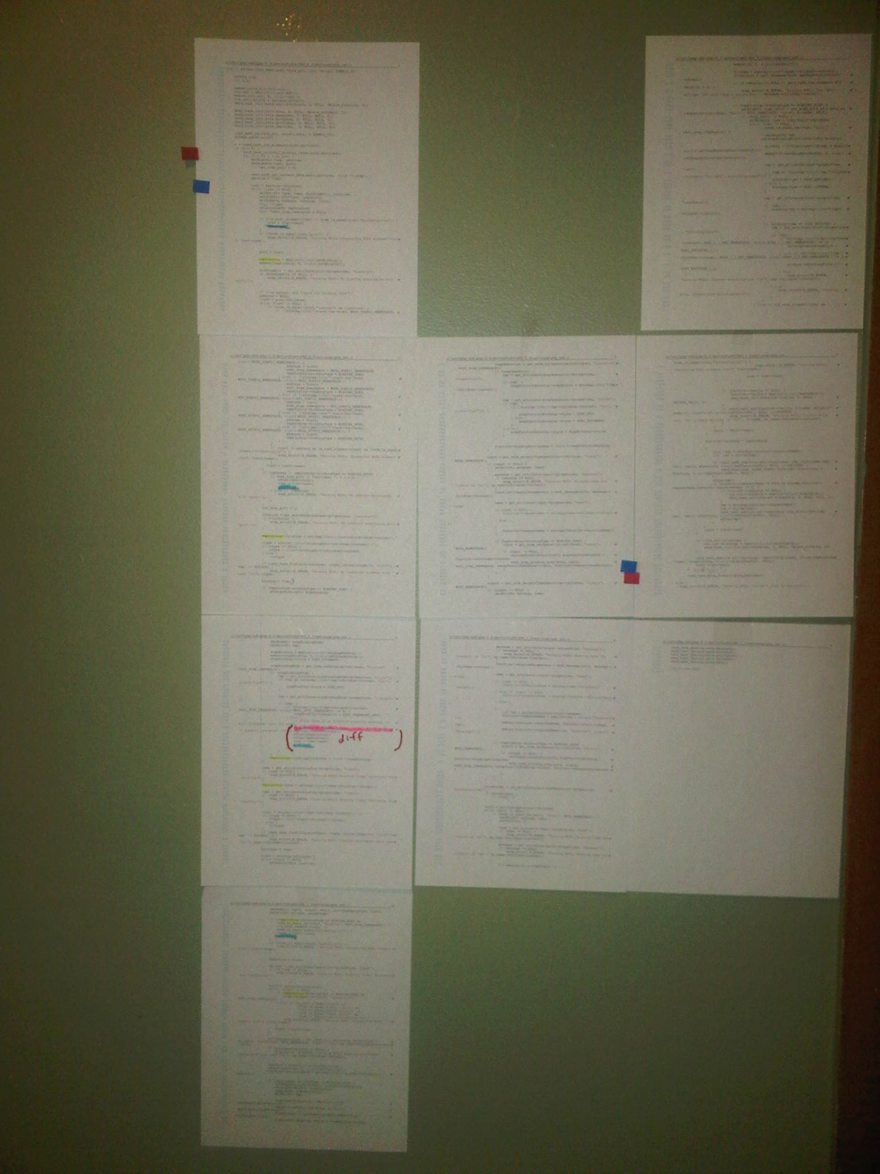
Advanced Debugging Techniques
Notes:
These 9 pages on my fiancee's apartment wall are one C function. Much of it seems to be validating the WSDL in ways that XSD validation would do.
I needed to do this to know where to put extra error handling for the new possible error conditions I was introducing.
Since this is C I had to clean up memory so I also had to see what variables were dynamically allocated so I could free them.

Slide 34
Advanced debugging techniques (cont)
I consider myself pretty adept with step through debuggers.
The function wasn't badly written. Sometimes a subroutine is just that long.
Comments would have helped
The resulting patch was less than 10 lines of new code
YMMV. Code in my second bug fix was smaller.

Slide 35
Recompiling and Retesting
Just rerun nmake/make and run-tests.php
Step through with a debugger if needed
Rinse and repeat until tests pass

Slide 36
Final Soap Patch
Index: php_sdl.c
===================================================================
--- php_sdl.c (revision 297347)
+++ php_sdl.c (working copy)
@@ -832,7 +832,12 @@
if (strncmp((char*)tmp->children->content, WSDL_HTTP_TRANSPORT, sizeof(WSDL_HTTP_TRANSPORT)) == 0) {
soapBinding->transport = SOAP_TRANSPORT_HTTP;
} else {
- soap_error1(E_ERROR, "Parsing WSDL: PHP-SOAP doesn't support transport '%s'", tmp->children->content);
+ // Since this is an E_NOTICE severity message, it will disappear into the ether.
+ soap_error1(E_NOTICE, "Parsing WSDL: PHP-SOAP doesn't support transport '%s'", tmp->children->content);
+ efree(soapBinding);
+ efree(tmpbinding);
+ trav = trav->next;
+ continue;
}
}
}
@@ -1128,6 +1133,10 @@
soap_error0(E_ERROR, "Parsing WSDL: Couldn't bind to service");
}
+ if (ctx.sdl->bindings == NULL || ctx.sdl->bindings->nNumOfElements == 0) {
+ soap_error0(E_ERROR, "Parsing WSDL: Could not find any usable binding services in WSDL.");
+ }
+
zend_hash_destroy(&ctx.messages);
zend_hash_destroy(&ctx.bindings);
zend_hash_destroy(&ctx.portTypes);

Slide 37
Dmitry's Version
Index: php_sdl.c
===================================================================
--- php_sdl.c (revision 299012)
+++ php_sdl.c (revision 299013)
@@ -832,7 +832,12 @@
if (strncmp((char*)tmp->children->content, WSDL_HTTP_TRANSPORT, sizeof(WSDL_HTTP_TRANSPORT)) == 0) {
soapBinding->transport = SOAP_TRANSPORT_HTTP;
} else {
- soap_error1(E_ERROR, "Parsing WSDL: PHP-SOAP doesn't support transport '%s'", tmp->children->content);
+ /* try the next binding */
+ efree(soapBinding);
+ efree(tmpbinding->location);
+ efree(tmpbinding);
+ trav = trav->next;
+ continue;
}
}
}
@@ -1128,6 +1133,10 @@
soap_error0(E_ERROR, "Parsing WSDL: Couldn't bind to service");
}
+ if (ctx.sdl->bindings == NULL || ctx.sdl->bindings->nNumOfElements == 0) {
+ soap_error0(E_ERROR, "Parsing WSDL: Could not find any usable binding services in WSDL.");
+ }
+
zend_hash_destroy(&ctx.messages);
zend_hash_destroy(&ctx.bindings);
zend_hash_destroy(&ctx.portTypes);

Slide 38
Submitting your fix
Submit your fix as a separate patch.
Add a comment to the bug explaining what needs to be explained.

Slide 39
Case Study Duex: IPv6 filtering
I was growing impatient with a lack of feedback on my original patch, and still unemployed.
I asked what grunt-work needed to be done. Bug 47435 was the answer.
I didn't know anything about Ipv6 so I had a little help from my friends.

Slide 40
Lessons learned from IPv6
The army is right, never volunteer
If you ask for grunt-work, you will get what other people consider grunt-work
  Corollary: If the bug was straightforward, it would have been done already.
Seek the opinion of SME's you know in real life.
  Offer to suffer the punishments of their good deeds. They will probably decline.
Notes:
It took me a while to understand exactly what I had to fix for this bug. This is mainly because I have never used Ipv6. My approach here was that of a consultant serving a client. I was given a set of requirements, clarified them, and executed them.

Slide 41
Partial Ipv6 patch
Index: ext/filter/logical_filters.c
===================================================================
--- ext/filter/logical_filters.c (revision 297627)
+++ ext/filter/logical_filters.c (working copy)
@@ -652,6 +652,7 @@
int ip[4];
int mode;
+ int value_strlen;
if (memchr(Z_STRVAL_P(value), ':', Z_STRLEN_P(value))) {
mode = FORMAT_IPV6;
@@ -707,11 +708,50 @@
}
/* Check flags */
if (flags & FILTER_FLAG_NO_PRIV_RANGE) {
- if (Z_STRLEN_P(value) >=2 && (!strncasecmp("FC", Z_STRVAL_P(value), 2) || !strncasecmp("FD", Z_STRVAL_P(value), 2))) {
+ // rfc4193 defines the subnet FC00::/7 as a private range.
+ if (
+ Z_STRLEN_P(value) >= 2 &&
+ (
+ !strncasecmp("FC", Z_STRVAL_P(value), 2) ||
+ !strncasecmp("FD", Z_STRVAL_P(value), 2)
+ )
+ ) {
RETURN_VALIDATION_FAILED
}
}
+
+ if (flags & FILTER_FLAG_NO_RES_RANGE) {
+ if (
+ // unspecified address (rfc4291)
+ (Z_STRLEN_P(value) == 2 && !strncasecmp("::", Z_STRVAL_P(value), 2)) ||
+ //(Z_STRLEN_P(value) == 6 && !strncasecmp("::/128", Z_STRVAL_P(value), 6)) || */
+ // loopback address (rfc4291)
+ (Z_STRLEN_P(value) == 3 && !strncasecmp("::1", Z_STRVAL_P(value), 3)) ||
+ //(Z_STRLEN_P(value) == 7 && !strncasecmp("::1/128", Z_STRVAL_P(value), 7)) ||
+ // fe80::/10 link local unicast (rfc4291)
+ (
+ Z_STRLEN_P(value) >= 5 && (
+ !strncasecmp("fe8", Z_STRVAL_P(value), 3) ||
+ !strncasecmp("fe9", Z_STRVAL_P(value), 3) ||
+ !strncasecmp("fea", Z_STRVAL_P(value), 3) ||
+ !strncasecmp("feb", Z_STRVAL_P(value), 3)
+ )
+ ) ||
+ // documentation addresses (rfc3849)
+ (Z_STRLEN_P(value) >= 9 && !strncasecmp("2001:0db8", Z_STRVAL_P(value), 9)) ||
+ // 6Bone
+ (Z_STRLEN_P(value) >= 2 && !strncasecmp("5f", Z_STRVAL_P(value), 2)) ||
+ (Z_STRLEN_P(value) >= 4 && !strncasecmp("3ff3", Z_STRVAL_P(value), 4)) ||
+ //TODO IPv4 Mapping ::ffff:0:0/96
+ // ORCHID addresses (rfc4843)
+ (Z_STRLEN_P(value) >= 8 && !strncasecmp("2001:001", Z_STRVAL_P(value), 8)) /* ||
+ // default unicast route address
+ (Z_STRLEN_P(value) == 4 && !strncasecmp("::/0", Z_STRVAL_P(value), 4)) */
+ ) {
+ RETURN_VALIDATION_FAILED
+ }
}
+ }
break;
}
}

Slide 42
Conclusions
Contributing PHP is fun, and good for the resume.
There's plenty of work to be done for the non C programmer
You need a lot of tribal knowledge to contribute to PHP. This is the biggest sunk cost to fixing your first PHP bug.

Slide 43
Getting these slides
Go to http://github.com/zippy1981/TalkMaterials/tree/master/NYPHP/2010-May/
Look on #NYPHP on twitter

Slide 44
FIN

